Slide 1
Predicting the Performance of Space Thrusters
DATASCI112: FINAL PROJECT
STUDENT: SELIN ERTAN

Slide 2
Introduction to Rocket Propulsion
Rockets are hard to build, expensive to analyse.
Rocket performance depends on multiple factors.
Thrust output is a direct measure of performance.
The propellant plays a crucial role in thrust output, but not enough to predict thrust output.
Significant factors: Mass Flow Rate, mission time, total propellant used, pressure, are some of them.

Slide 3
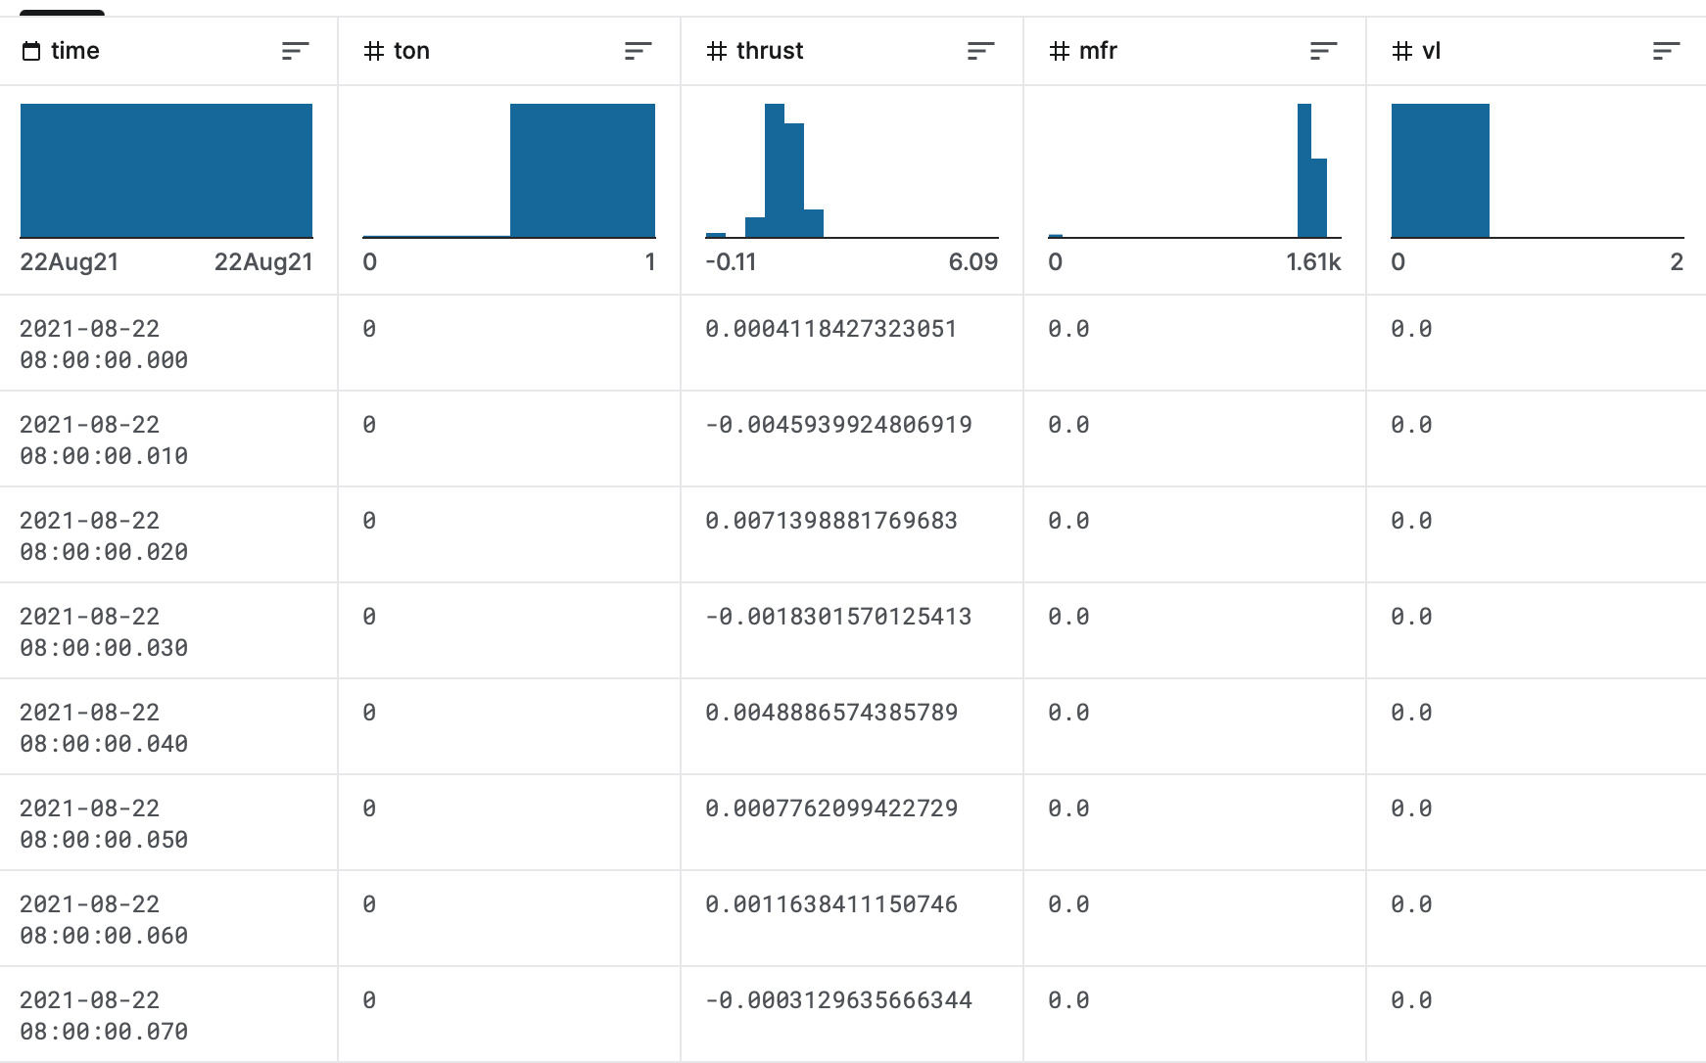
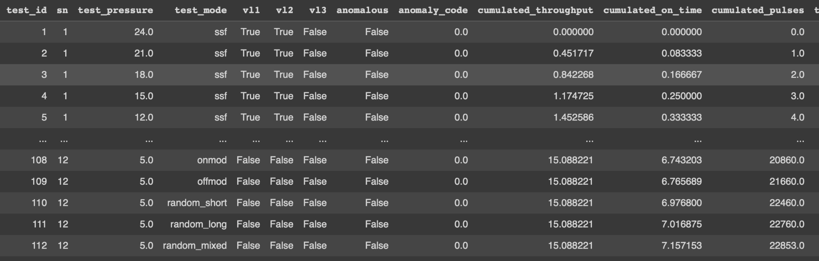
Data Collection
Data has been collected from Kaggle through an API. https://www.kaggle.com/patrickfleith
Data included 2000+ firing tests as separate csv files along with external factors’ information. Thrust Root Mean Squared, MRF Averaged.
Most significant factors: TO, MFR, pressure

Slide 4
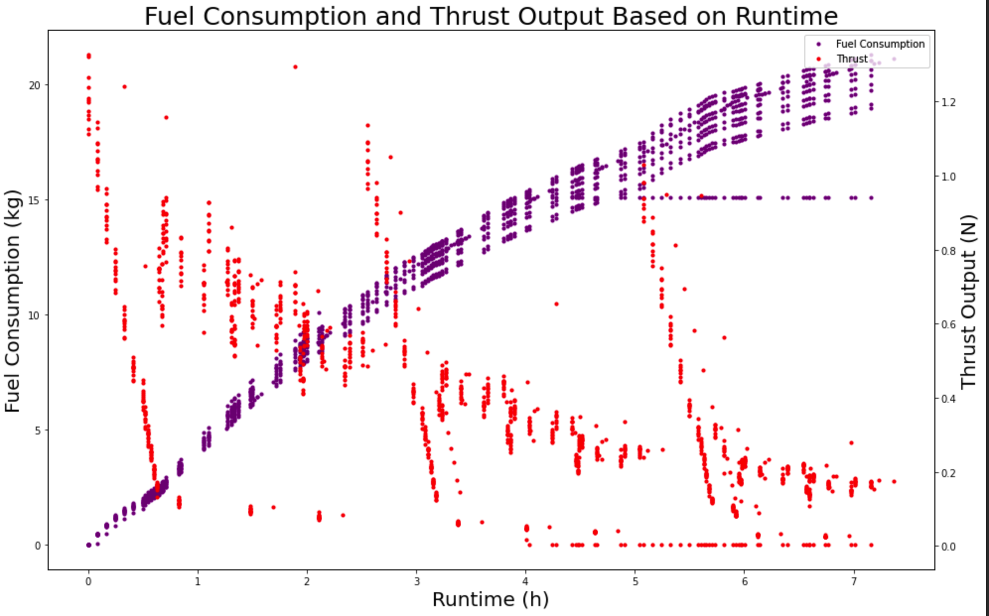
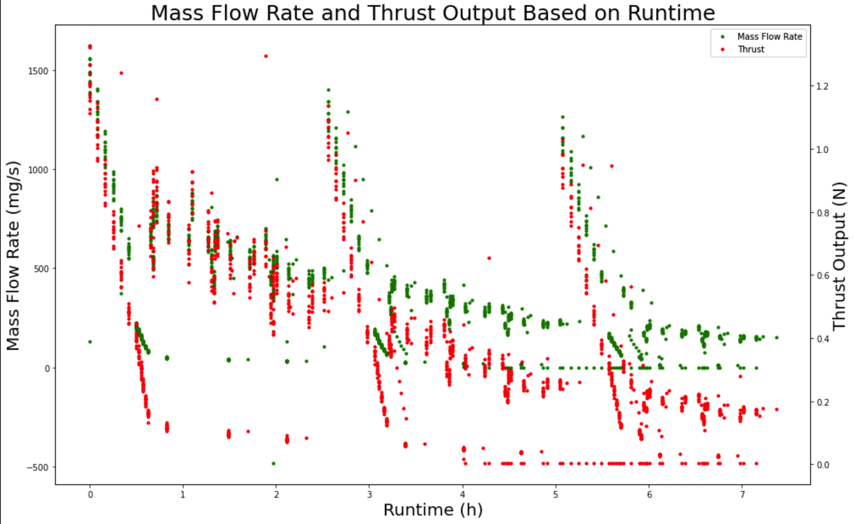
2. Data Exploration
This means that the increase in the fuel consumption must relate to the pressure increase within chamber.

Slide 5
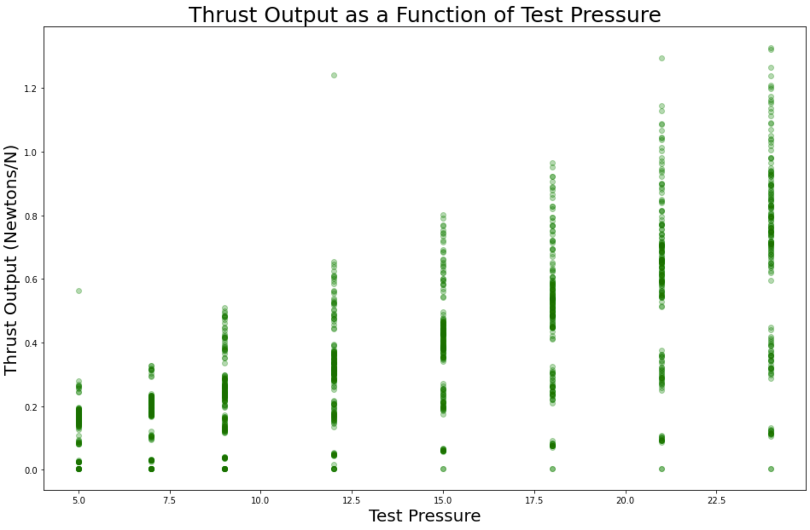
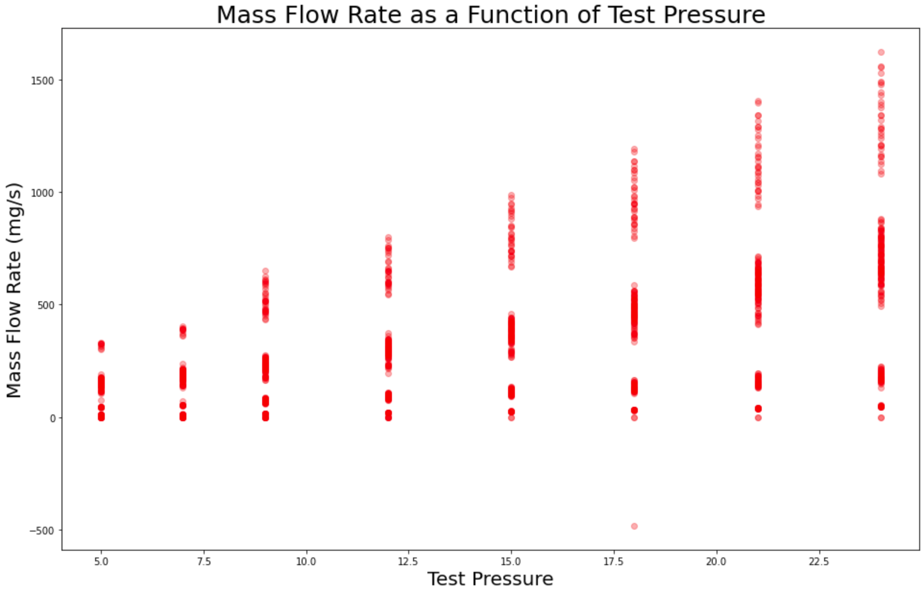
Further Exploration
The propellant was released in bursts, explaining the erratic behavior. Thrust and MFR definitely correlated.

Slide 6
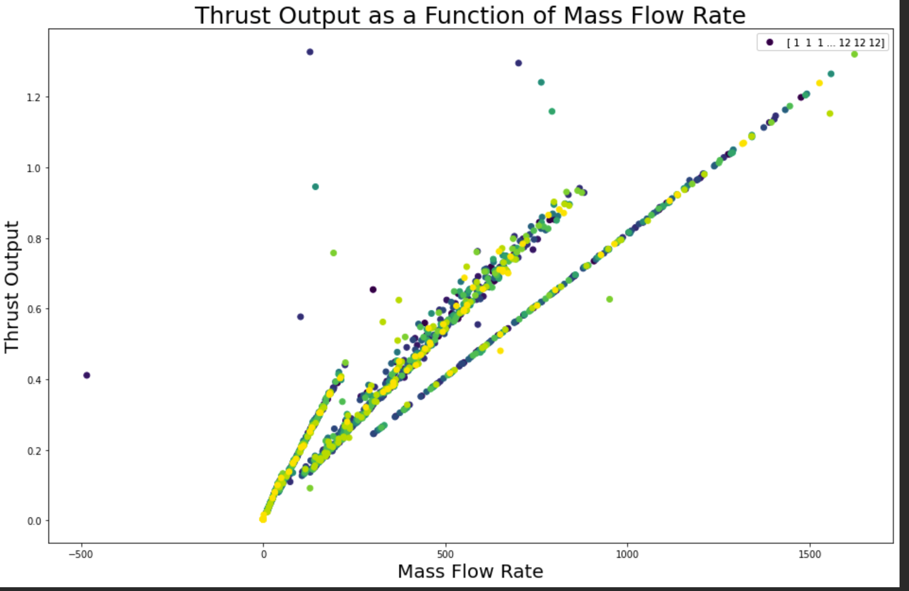
Even Further Exploration
Three main groups.
Same setup is part of all three slopes.
The same setup may have different thrust outputs for the same MFR.
The same setup could also be growing at a different rate once scaled!

Slide 7
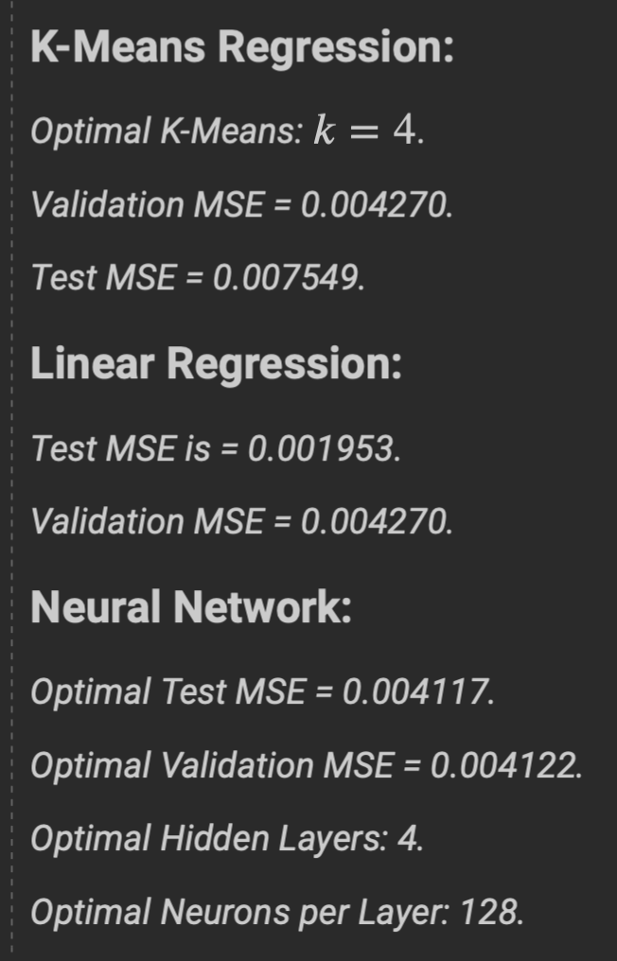
3. ML Models
Linear Regression performed the best after training the model on "test_pressure", "test_mode", "cumulated_throughput", "cumulated_on_time", "cumulated_pulses", "mfr_avg".
And predicting: "thrust_rms"
(Neural Network -> MLPRegressor)

Slide 8
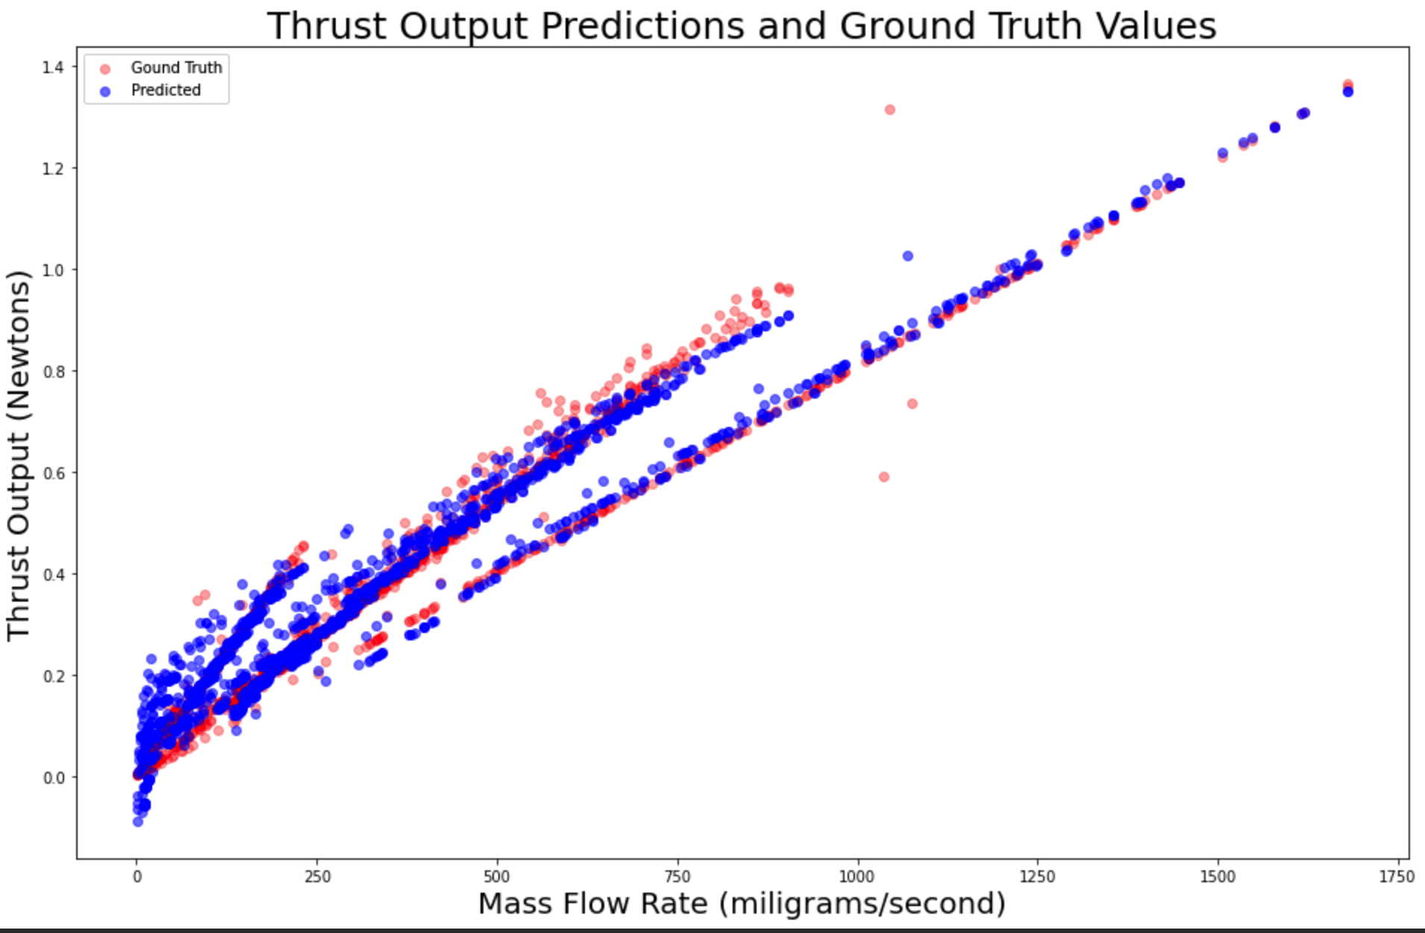
4. Results:
What do we learn?
Thrust can be predicted accurately without making a measurement, even building the setup.
Same setup may have different scalability factors based on environment conditions.
Where Math fails, Data Science thrives.

Slide 9
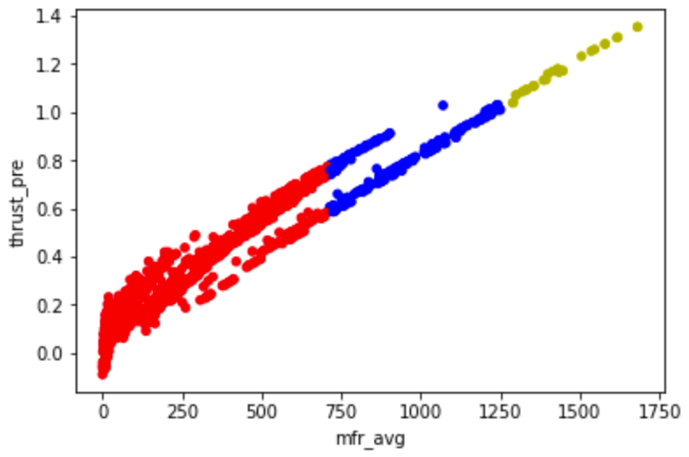
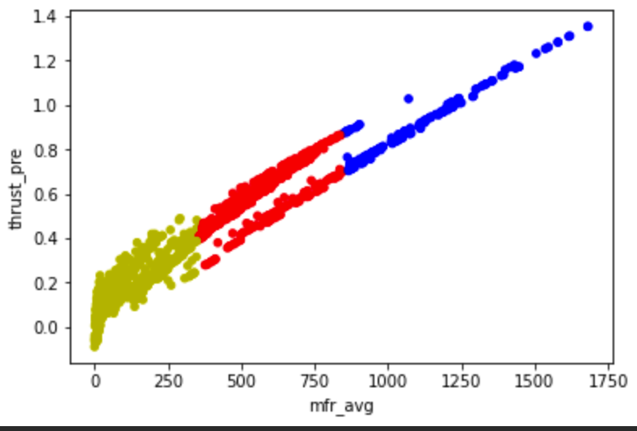
Next Steps:
Clustering completely failed. But if it succeeds, then we can know whether we can scale an engine without even building it!
Agglomerative Clustering
KMeans Clustering

Slide 10
Thank you! Questions?

